Slide 1
Environmental Criminology Research: Week 1
Finian Lugtigheid

Slide 2
Research
Various Environmental Criminology Research Papers
Environmental Criminology (Chapter 3)
Built Environment, Land Use, and Crime (Wuschke & Kinney, 2018)
Street Networks and Crime (Davies & Bowers, 2018)
Computer Simulations: Agent-Focused Environmental Criminology (Birks, 2018)
Measuring the Built Environment with Google Street View and Machine Learning (Hipp et al. 2021)
Others

Slide 3
Research
Dr. Parks Previous Work
Differences in Geographic Profiles When using Street Routing Versus Manhattan Distances in Buffer Zone Radii Calculations (2021)
Residential Burglary Prediction Using Deep Learning (2020)
Graph Model of Environmental Backcloth (2022)
Social Network Analysis of Global Transshipment (2020)
Street Profile Analysis (2016)
Investigating Historical Crime Importance in Vancouver (2021)

Slide 4
Research
Other Research
Some of Environmental Psychology (Gifford 1987)
The Porch Pirate Problem (McKay 2021)
Porch Pirates: Examining Unattended Package Theft Through Crime Script Analysis (Hicks et al. 2019)

Slide 5
Research Ideas
Improving zone radii calculations for predicting anchor points by varying P-Norm equations
Using ABMs to determine whether street betweenness causes criminals to commit more crimes or simply has more criminals
Using Social Network Analysis to find online scammer networks
Something to do with Porch Pirates (Gateway crime)
Analyze car breakins in San Francisco (SNA?)
Building upon the graph model of the environmental backcloth

Slide 6
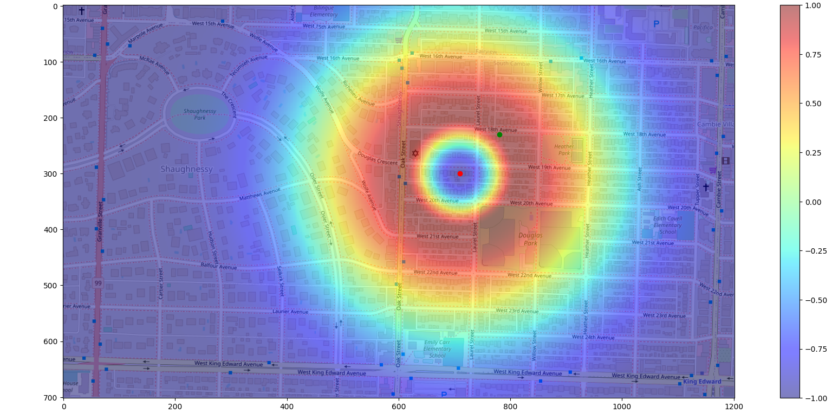
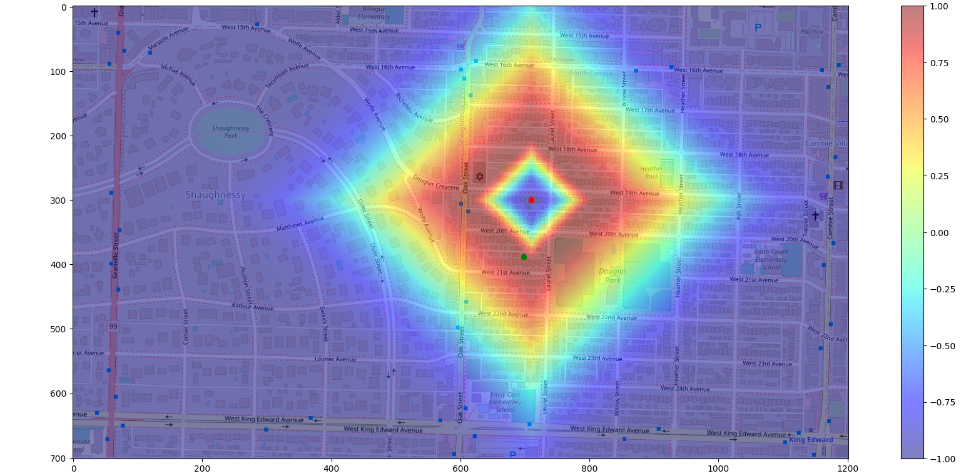
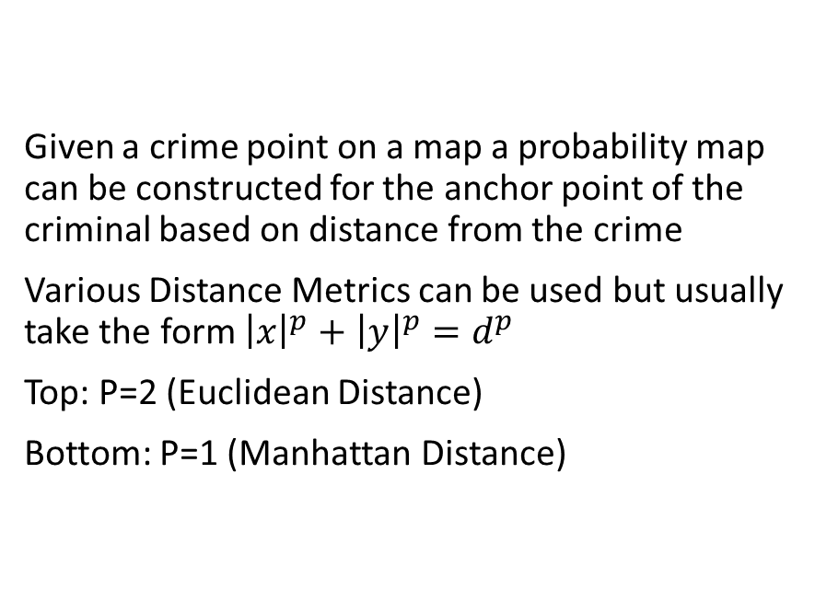
Radii Calculation Sample
Given a crime point on a map a probability map can be constructed for the anchor point of the criminal based on distance from the crime
Various Distance Metrics can be used but usually take the form ${\left|x\right|}^{p}+{\left|y\right|}^{p}=d^{p}$
Top: P=2 (Euclidean Distance)
Bottom: P=1 (Manhattan Distance)

Slide 7
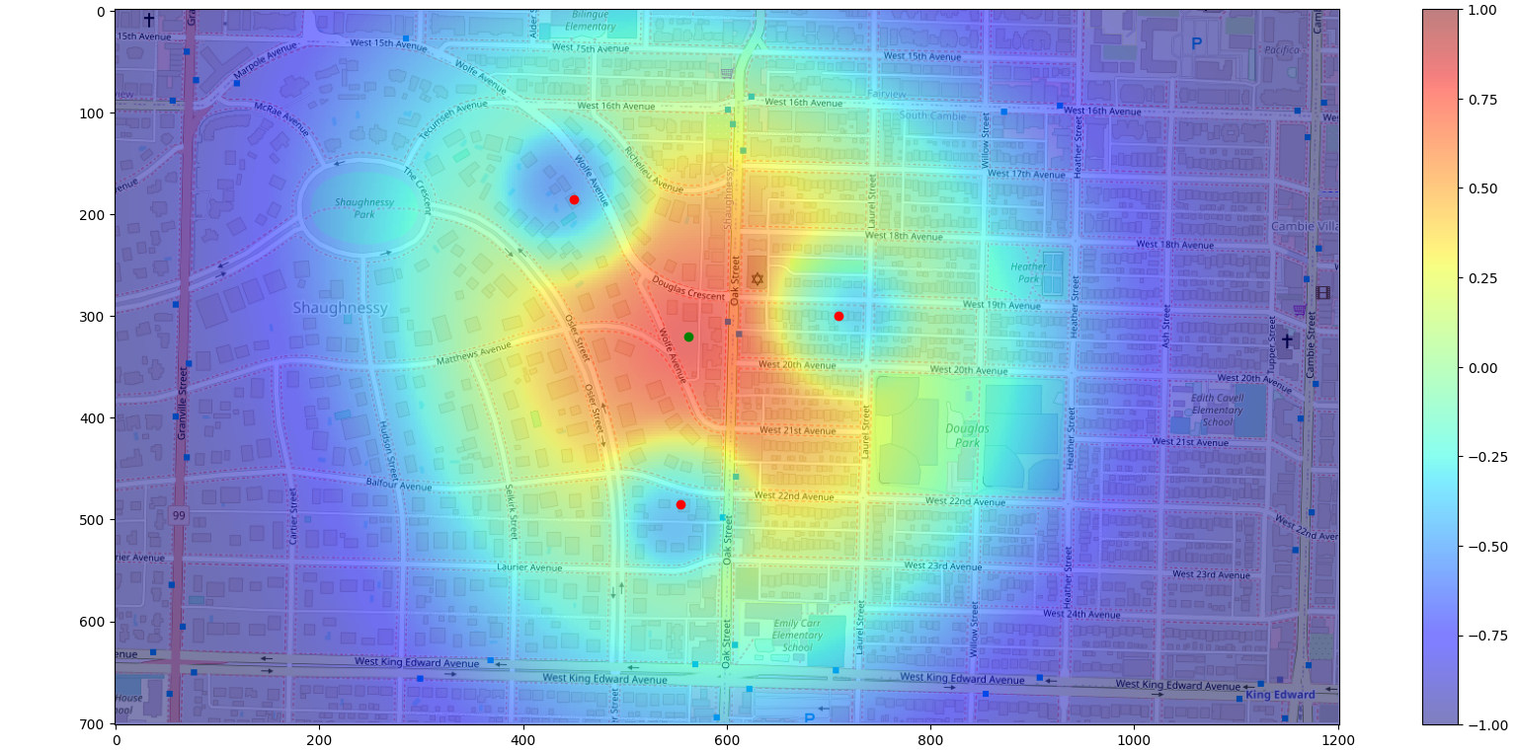
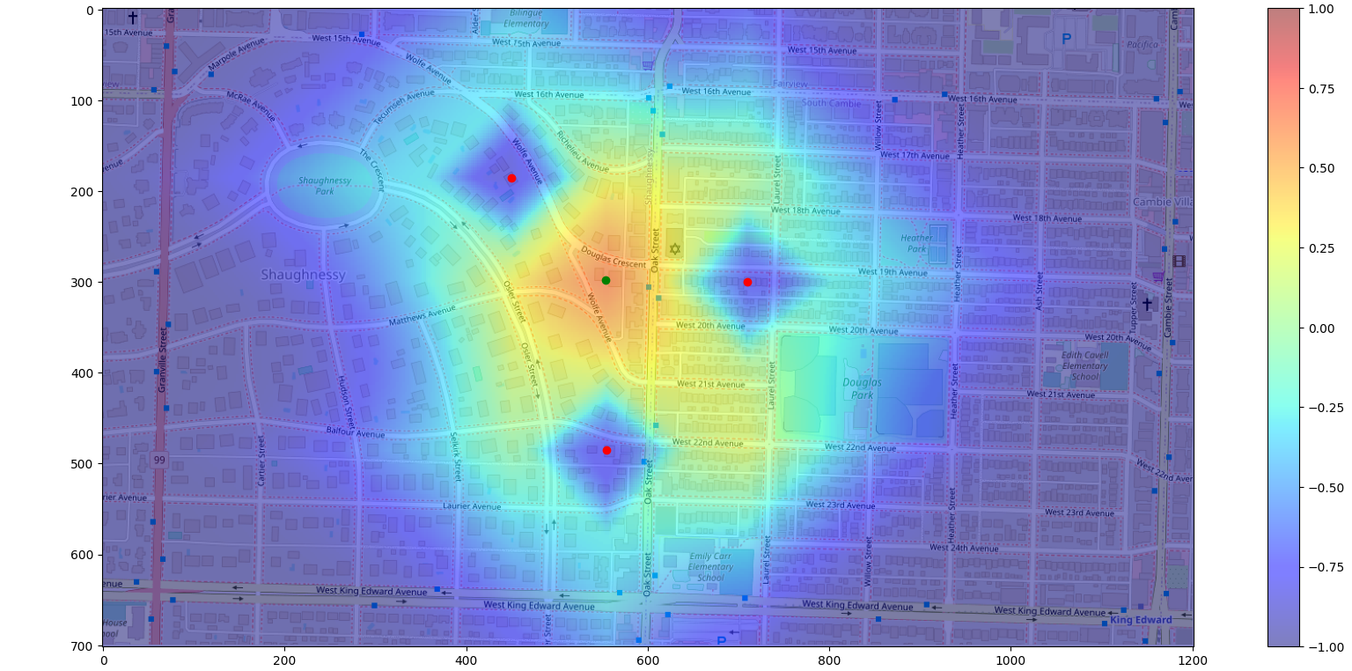
Radii Calculation Sample
Multiple crimes can be analyzed with the probability for each crime layered on top of each other to get a probability distribution for multiple crimes
Top: P=2 (Euclidean Distance)
Bottom: P=1 (Manhattan Distance)

Slide 8
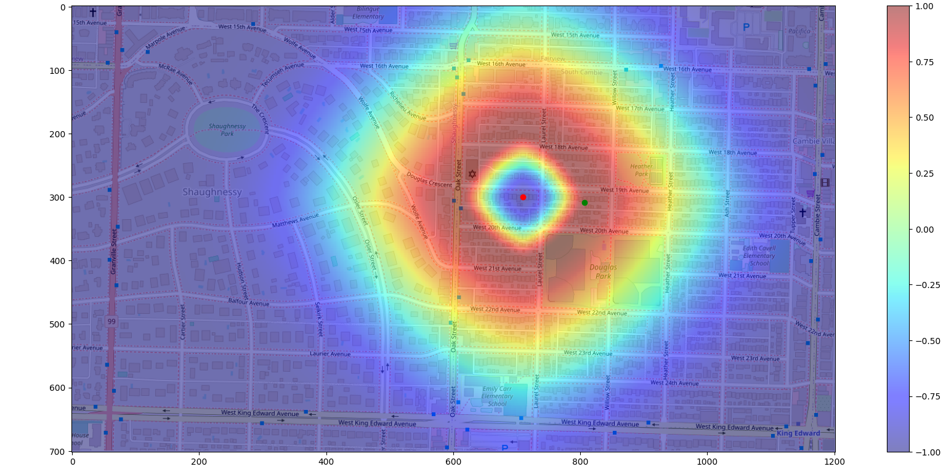
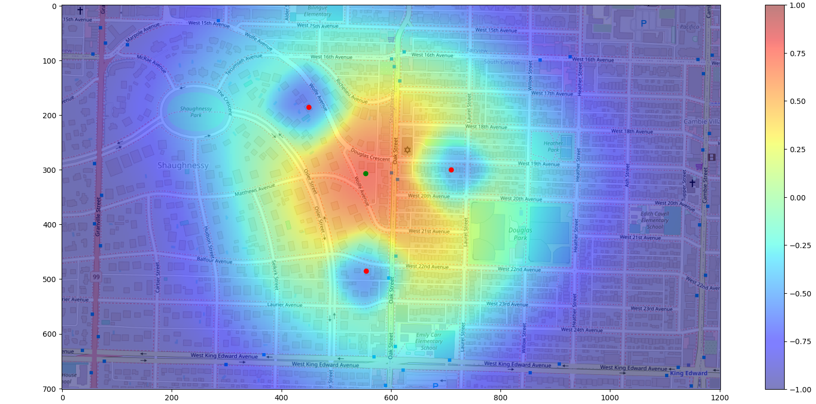
Radii Calculation Sample
P can also take on non integer values. When it is in the range (1, 2) the resulting distance function is between the Euclidean and Manhattan distance function.
Top: P=1.5 on a single crime point
Bottom: P=1.5 on three crime points

Slide 9
Comparison of the various P values on 1 and three crime points
Top: P=1
Middle: P=1.5
Bottom: P=2

